Slide 1
Graph Theory
—Introductory
Coach: TaoSama

Slide 2
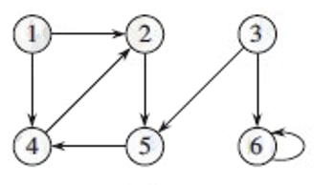
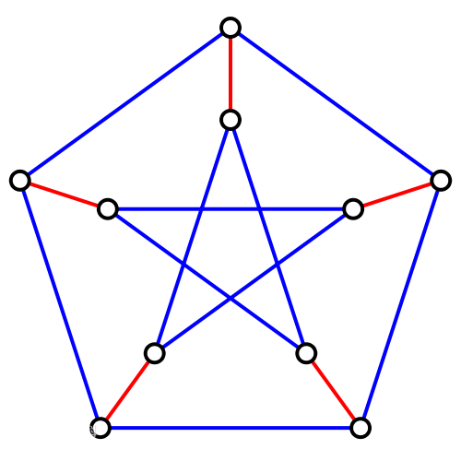
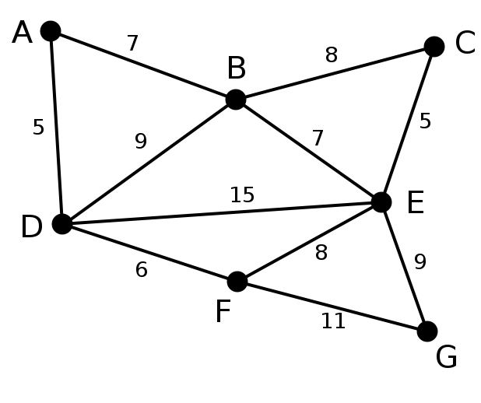
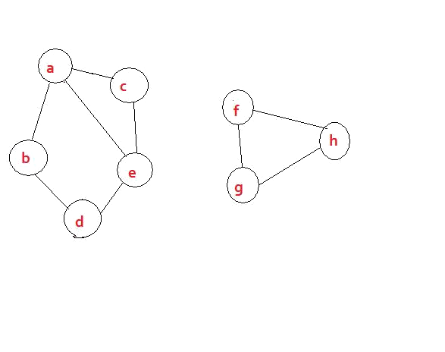
有向？无向？
有权？无权？
连通？非连通？
树？森林？
路径？圈？环？
入度？出度？
Ⅰ. What is Graph？

Slide 3
Ⅱ. How to store a Graph ？
As to a Graph, G = (V, E)
We need to store the V and the E.

Slide 4
Ⅱ. How to store a Graph ？
Representation？
Adjacency-matrix
Adjacency-list
链式前向星（边集数组、静态邻接链表）

Slide 5
Adjacency-matrix

Slide 6
2) Adjacency-list

Slide 7
3) 链式前向星

Slide 8
Ⅲ. How to iterate a Graph ？
Dfs
Bfs
Iterate a Tree ？
Pre-Order
In-Order
Post-Order

Slide 9
Ⅳ. Duang~ Come to our Points？
Bellman-Ford
SPFA
Dijkstra
Floyd-Warshall
Shortest path
Minimum spanning tree
Prim
Kruskal

Slide 10
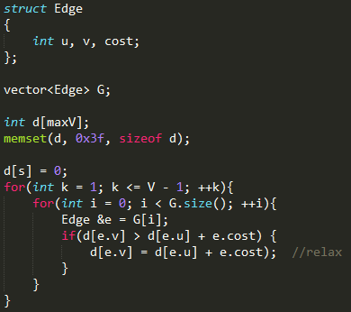
一、Shortest Path
Bellman-Ford
O(VE)

Slide 11
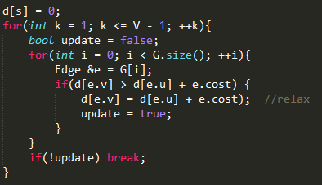
Optimize？
As researched, test with
random data.
1.13|E|
if |E|<|V|
0.95*|E|*log|V|
if |E|>|V|
If found, break the loop.

Slide 12
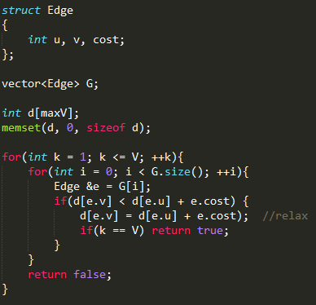
If there exists negative loop？
O(VE)
Find them all!

Slide 13
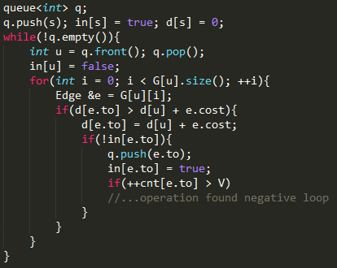
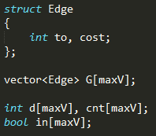
一、Shortest Path
O(kE)？
2) SPFA (Bellman-Ford with queue)

Slide 14
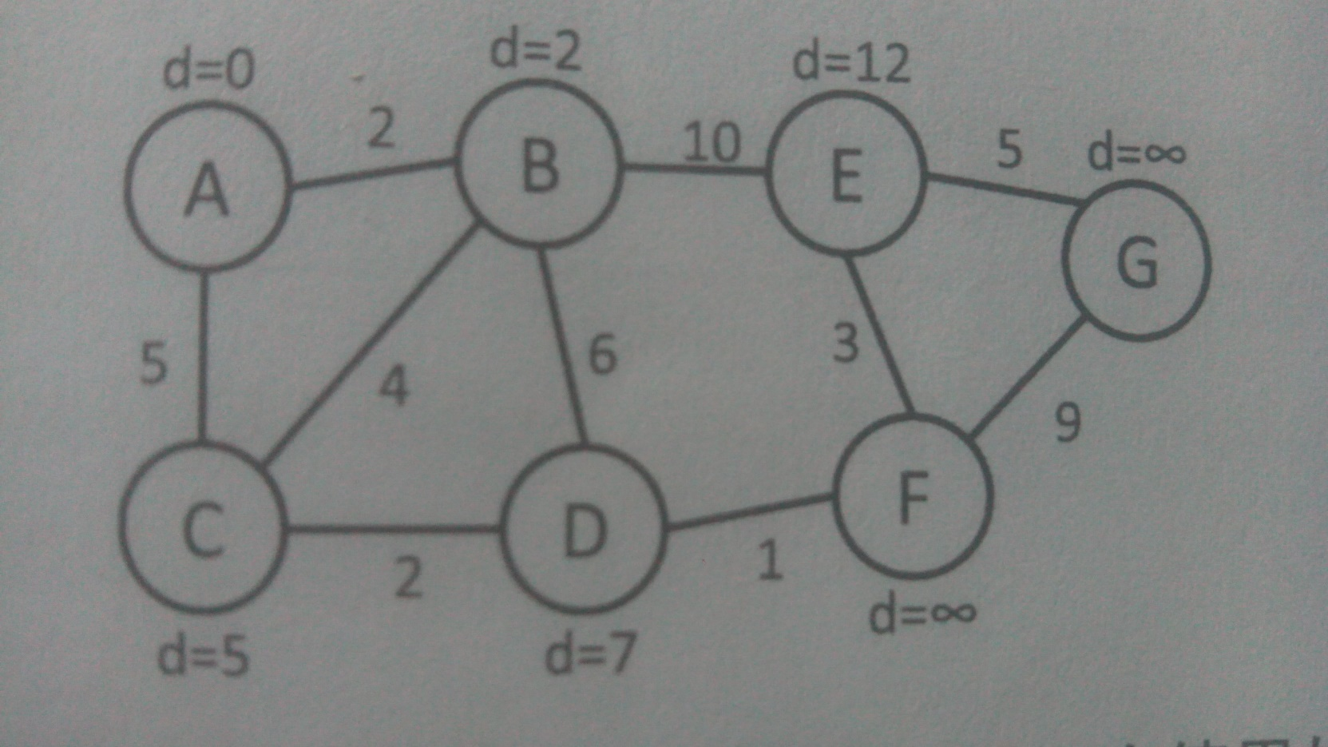
一、Shortest Path
3) Dijkstra

Slide 15
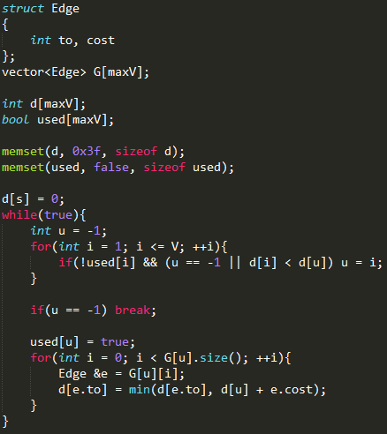
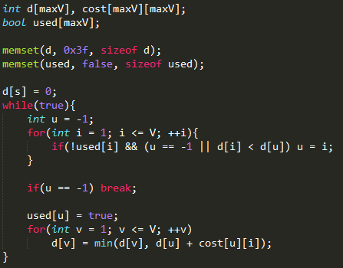
O(V^2 + E) = O(V^2)
>=
O(V*2V) = O(V^2)

Slide 16
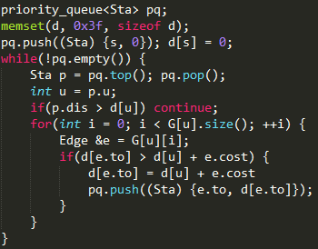
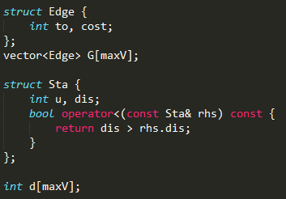
Optimize with minimum heap!
O(ElogV)

Slide 17
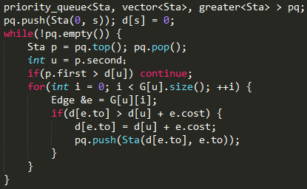
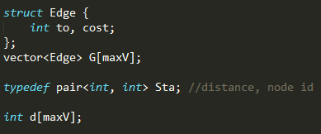
use std::pair !

Slide 18
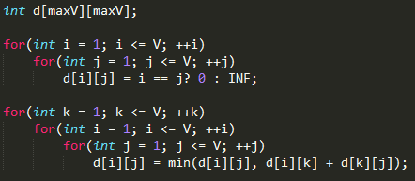
Shortest Path
4) Floyd-Warshall
O(V^3)

Slide 19
例题选讲
次短路
某街区有R条道路，N个路口，道路双向通行，问1号路口到N号路口的次短路长度是多少？
次短路是指比最短路道路长的次短路径。
1<= N <= 5000
1<= R <= 10^5

Slide 20
例题选讲
POJ 1932 XYZZY
有N个房间，每到达一个房间会获得或者减少体力值，
初始位于1号房间，拥有100点体力值，房间可以重复通过来获取体力值。到达某个房间的体力值必须大于0才能获取当前房间的体力值
1 <= N <= 100

Slide 21
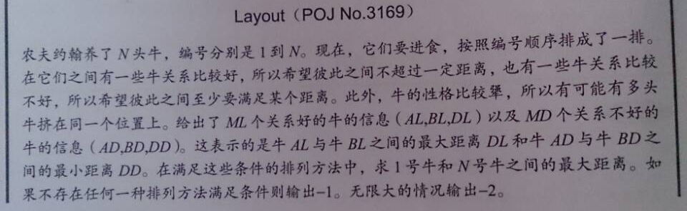
例题选讲
Differential Constraints
2 <= N <= 1000
1 <= ML, MD <= 10000
1 <= AL < BL <= N
1 <= AD < BD <= N
1 <= DL, DD <= 10^6

Slide 22
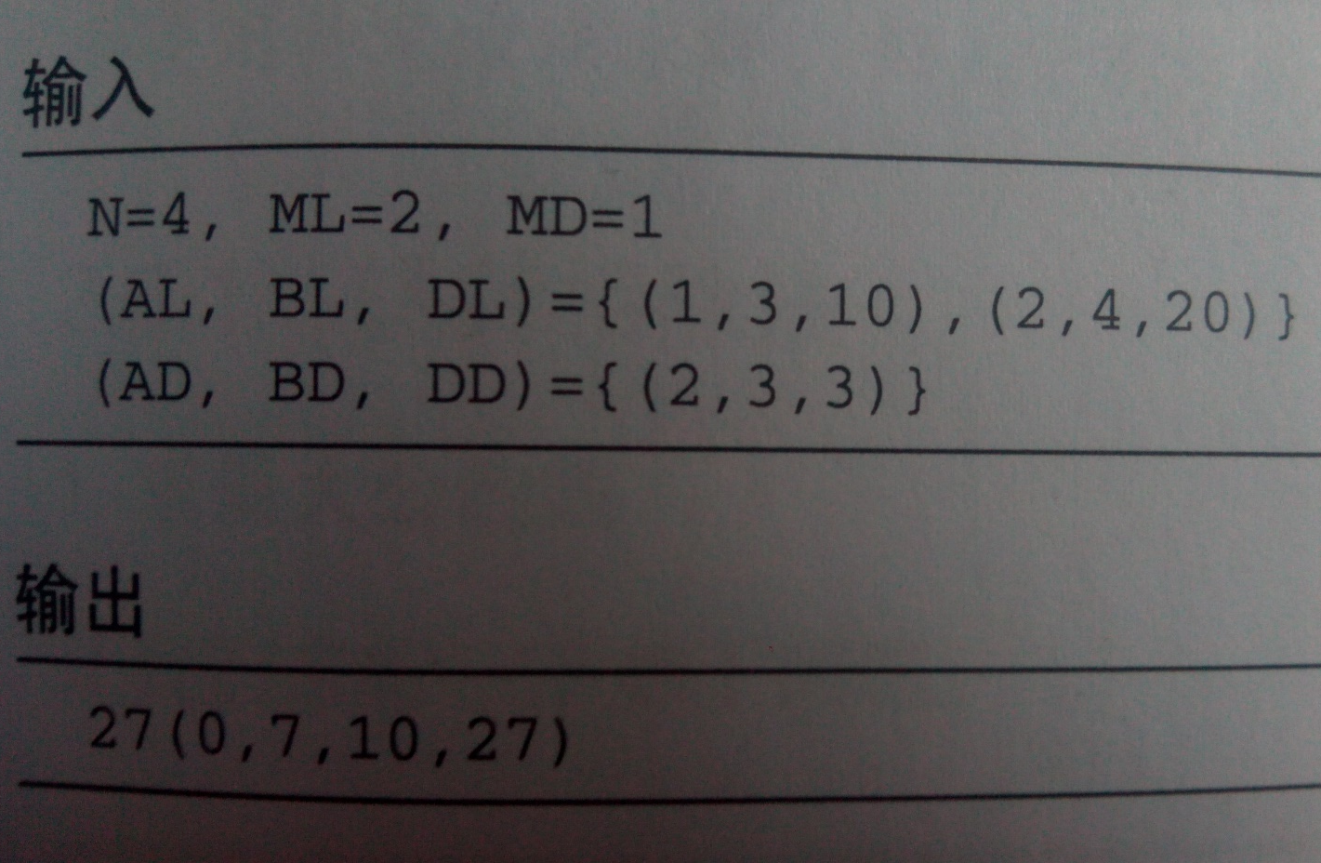
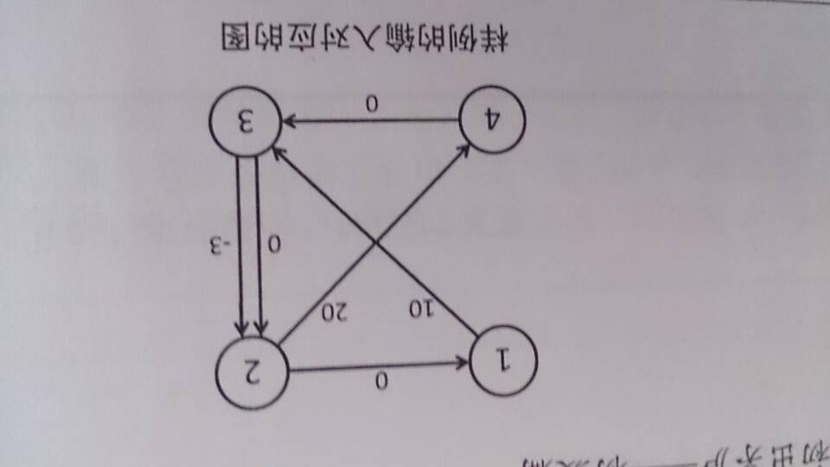
Differential Constraints

Slide 23
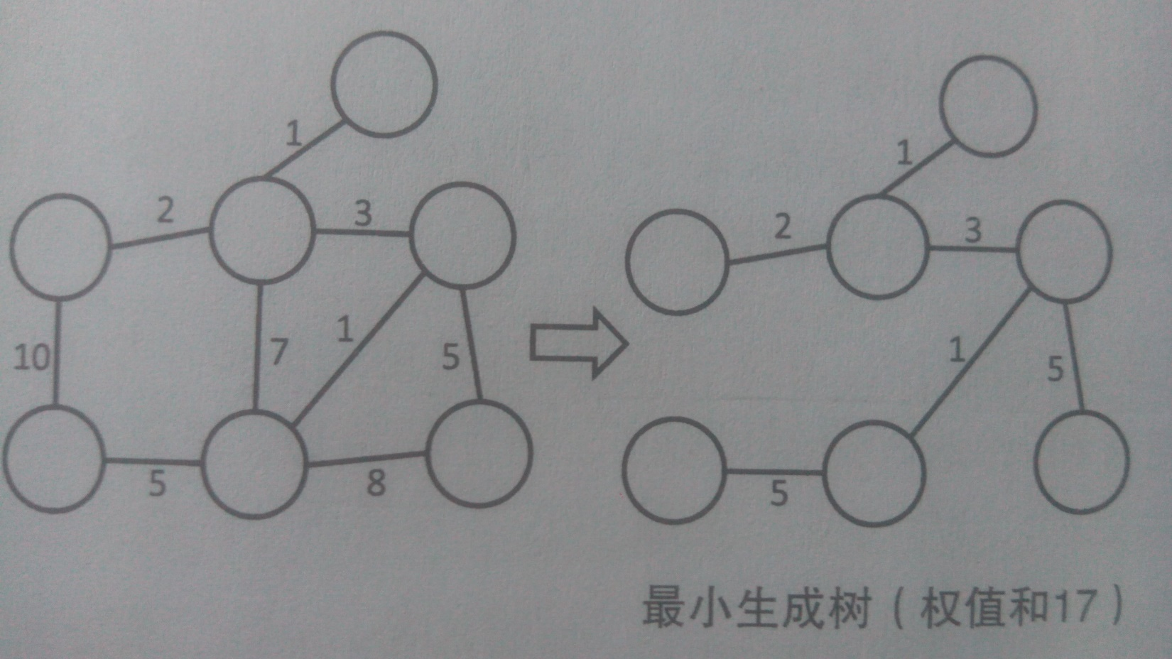
Minimum Spanning Tree
1) Prim

Slide 24
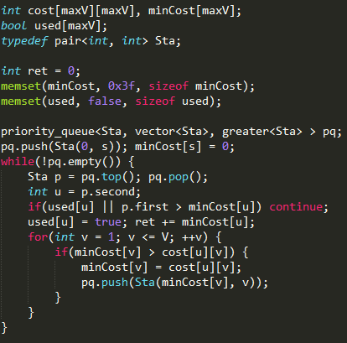
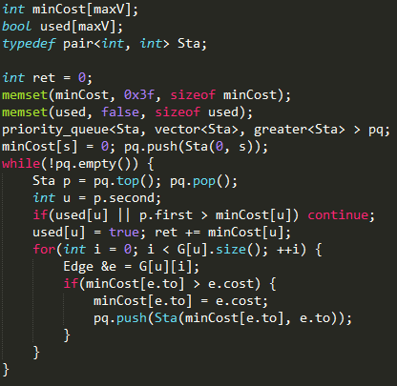
O(V^2logV)
>=
O(ElogV)

Slide 25
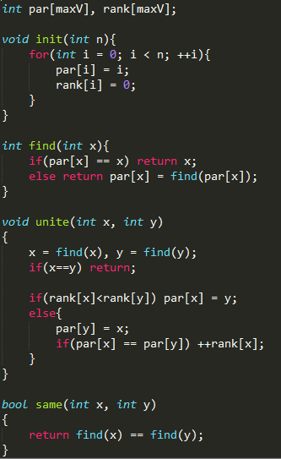
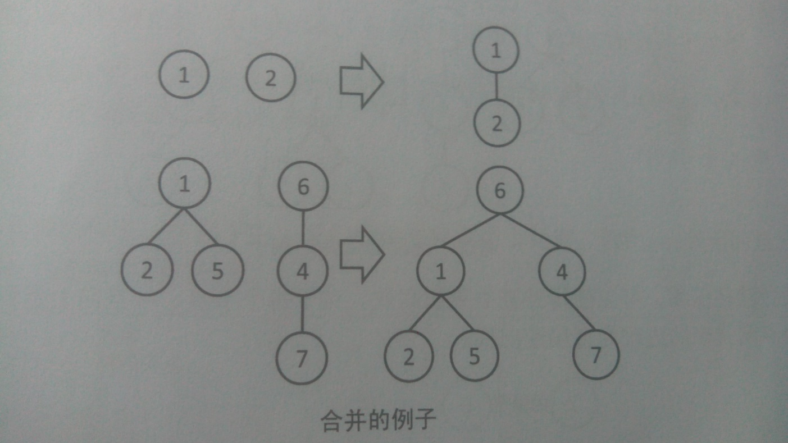
Minimum Spanning Tree
2) Kruskal
O(α(n) )

Slide 26
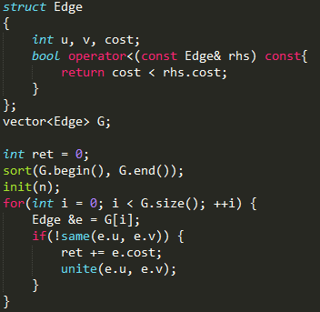
O(ElogE + ElogV)

Slide 27
Minimum Arborescence

Slide 28
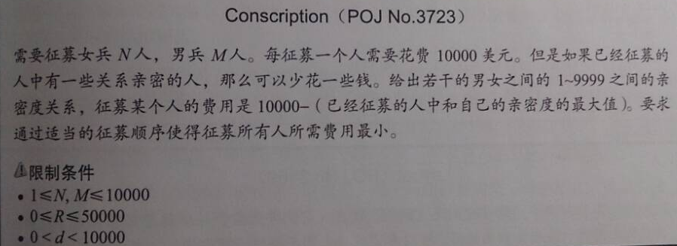
例题选讲
Maximum Spanning Forest

Slide 29
Flows

Slide 30
Bipartite Graph

Slide 31
Connected Graph

Slide 32
Topological Sort

Slide 33
Eulerian Path or Circuit

Slide 34
2-SAT

Slide 35
Clinique and Chordal Graph(团与弦图)
Chord: 连接环中不相邻的两个点的边
一个无向图称为弦图，当图中任意长度大于3的环都至少有一个弦
弦图最小染色 -> 完美消除序列-> MCS算法

Slide 36
Planar Graph
Flow and Cut
Global Minimum Cut

Slide 37
Tournament Graph
Landau’s Theorem

Slide 38
Searching on Graphs
Maximum Matches
Maximum Cliniques
Ramsey Theorem
Some Others

Slide 39
Some Others
K-th Minimum Shortest Path

Slide 40
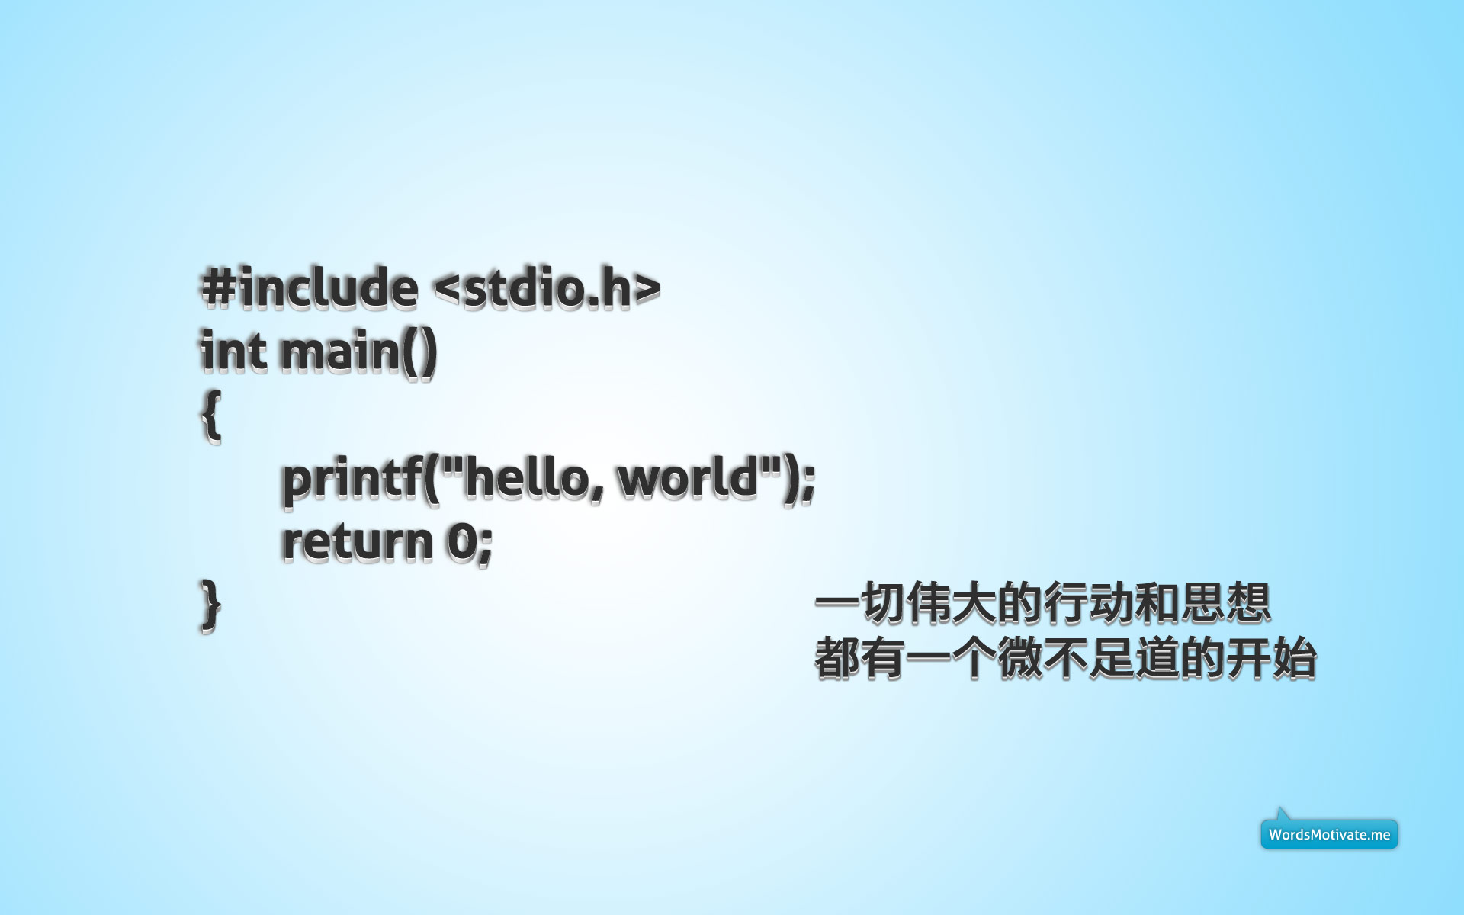
祝诸君武运昌隆！

